Slide 1
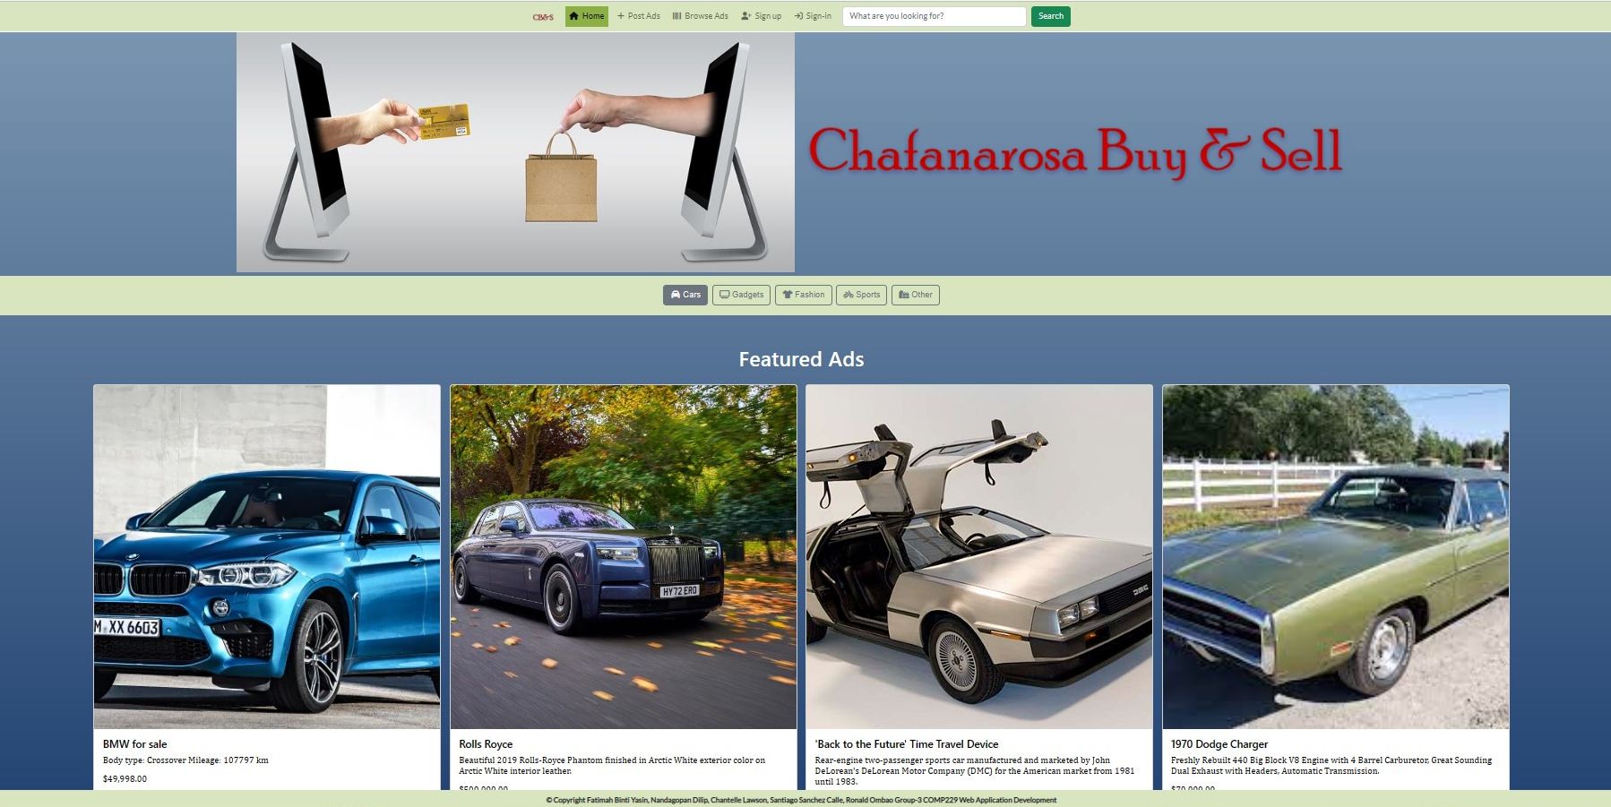

Slide 2



The e-commmerce website by COMP229's Group 3
Chantelle Lawson
Fatimah Binti Yasin
Nandagopan Dilip
Ronald Jr Ombao
Santiago Sanchez Calle

Slide 3
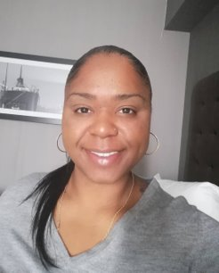



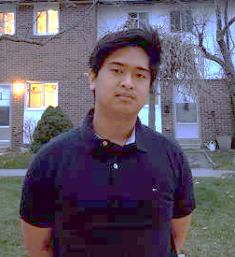
The ChaFaNaRoSa Team
Fatimah
Web Designer
Ronald
Lead Software Engineer
Chantelle
Project Manager
Nandu
Database/Security Programmer
Santiago
UI Programmer

Slide 4
Web Application Overview
Project type: Selling Used Items
E-commerce web application for users to sell and buy items
Unauthorized users: view products for sale and contact seller via email
Users can become site members by signing up
Users that sign up and login are authorized to create, read, update and delete products from the website’s database

Slide 5
Planned Features
Unauthorized users view products for sale and contact sellers via email to make a purchase.
Unauthorized users will have the option to become site members by using an electronic sign-up form.
Authorized users will have the ability to create, update, and delete inventory items.
The seller can create a lifetime for their advertisement by setting up the active and expiry date.
The user can send questions regarding an active ad anonymously to the ad owner.
Only the ad owner will have access to answer the question and store it in the database for future customers reference.
If the user wants to delete an ad, they should expire the ad.

Slide 6
Basic Feature
Instructions
On the landing page, there is a navigation bar which showcases different categories of products and featured ads for each category. The user can choose products from that page or search for products in the top search bar.
Browse Ads
Create an Ad
To create an ad, user registration and login is compulsory. Once the user is authorized, they will have the access to create, edit, delete the advertisement.
Delete an Ad
To delete an ad, the seller required to disable or expire the ad.

Slide 7
Basic Feature
Instructions
Under each ad description, there is the option to ask the owner. The user can send the question anonymously as well. The question will remain in the ad description page for future customer's reference.
Ask about an ad
Answer user queries
The owner will only have access to answer the question and it will be stored in the database for later use.
Token expiry
Every time a logged-in user navigate to a secured area or perform certain action, the system will check if the token is still valid.

Slide 8
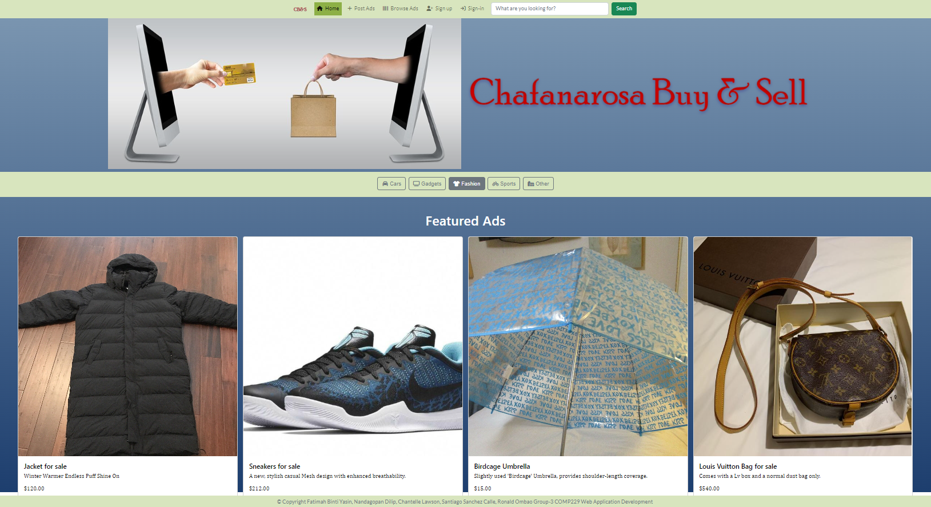

Home page

Slide 9
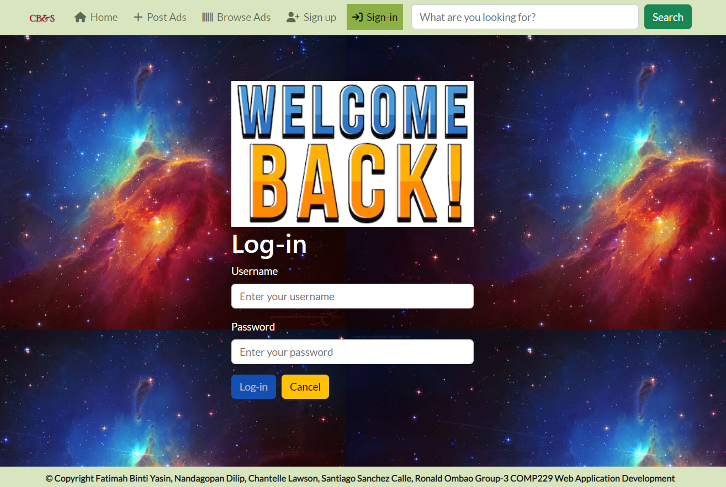

Sign-in

Slide 10
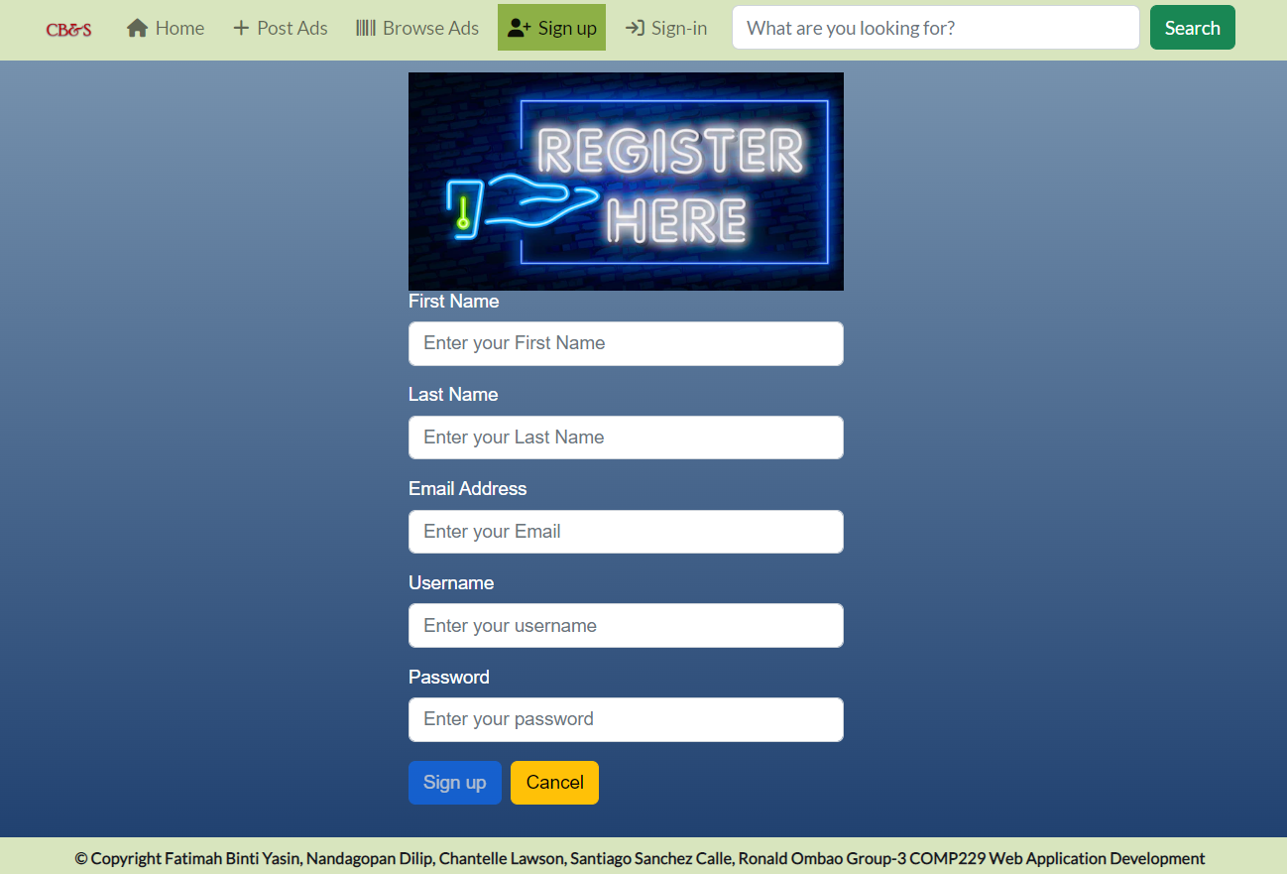
Sign-up

Slide 11
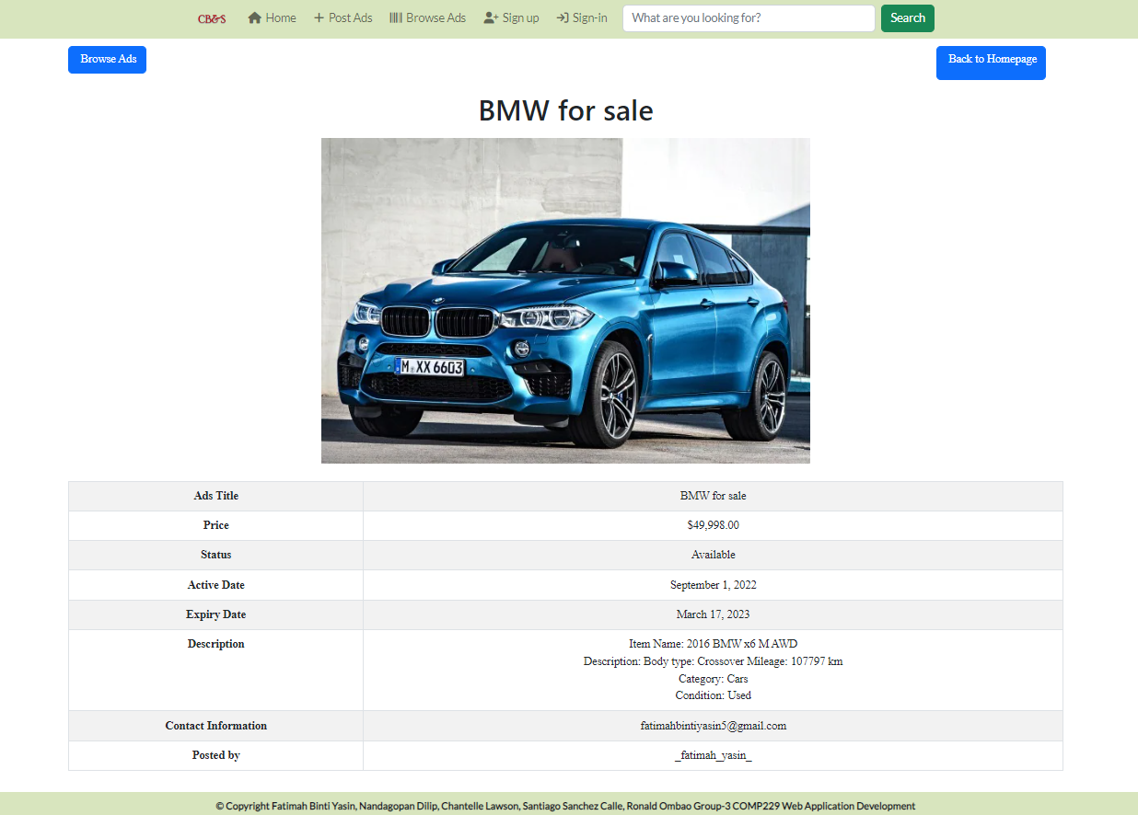

Ads
Ad description

Slide 12

Site Demo

Slide 13
Team Retrospective
Challenges
Different Approach
Stick to host site's free features rather than attempt changing into Google for web hosting
Heroku host site
Jwt transition
Moving from the session-based authentication to jwt was time consuming and required extra time and testing
Angular
It took extra time for team members working the Angular framework to learn it and implement it

Slide 14
Future Possibilities
A wish-list where the user can add the products that they are planning to buy in future
A Similar products you may be interested in site where the user can see some items with same category or price range.
A Rate the seller feature which will allow the buyer to rate the seller so that other customer can trust the seller
Sustainable products and eco-friendly filter

Slide 15

Future Possibilities
Pagination - avoids fetching all records at once
Search Bar – add search functions from the site database
Mobile application – make website adjustable to different screen sizes

Slide 16

Member contributions
Chantelle – Project Management with Jira and Front End CSS
Fatimah – Web page design, Ads Images and Final Presentation
Nandu – Back End Features, Image upload function
Ronald – Front End Angular functions, jwt
Santiago – Front End features, Logo design and Final Presentation

Slide 17

On behalf of Group 3, Thank you for watching!

